Slide 1

K.R.MANGALAM UNIVERSITY
probabilistic modelling and reasoning with python
Course: B.TECH CSE(AI&ML)
ROLL NO. 2401730089
SUBJECT CODE: SEC03
BY RISABH KUMAR

Slide 2

EXPLORATORY DATA ANALYSIS OF AMAZON DATASET
Analyzing the dataset to summarize its main characteristics often visualizing it.

Slide 3
WHY THIS PROJECT?
Amazon is a global leader in e-commerce, and its vast ecosystem of products, reviews, and user data offers rich opportunities for analysis. Analyzing Amazon data provides valuable insights for businesses, marketers, data scientists, and developers.
Choosing Amazon data analysis with Python can be advantageous for several reasons. Amazon provides a vast and diverse set of data

Slide 4


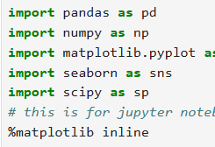
HOW WAS THIS ACHIEVED ?
Pandas: For data manipulation and analysis.
Matplotlib & Seaborn: For creating visualizations.
NumPy: For numerical operations.
Seaborn: For any advanced data processing.

Slide 5

OUTCOME
Key Findings and Screenshot's

Slide 6

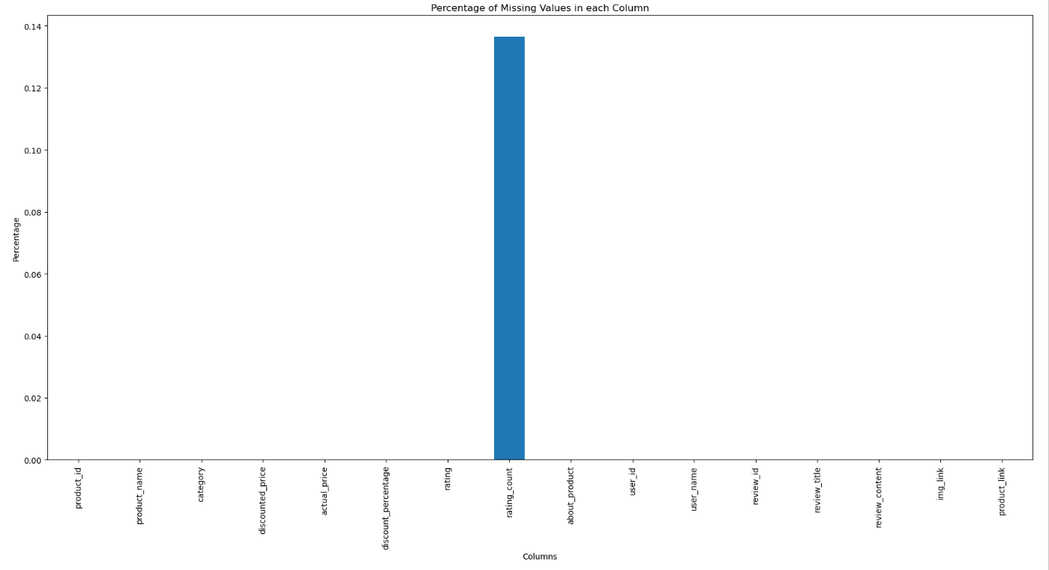



Percentage of missing value in each column

Slide 7
Percentage of missing value in each column
Analyzing Missing Values
Assuming you have an Amazon dataset in a CSV file format (e.g., amazon_data.csv), the first step is to calculate the percentage of missing values in each column
Calculate the Number of Missing Values and Their Percentage
Step 2: Visualizing the Missing Data
You can also visualize the missing data to make your findings more engaging.

Slide 8
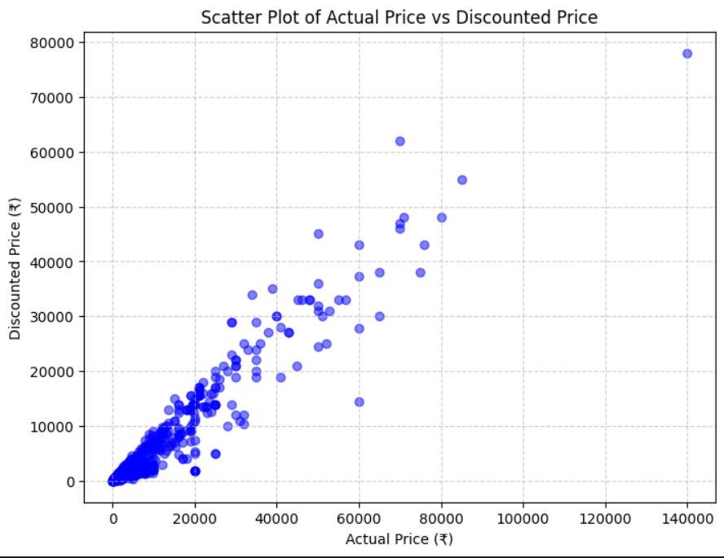
Plot distribution of actual price

Slide 9
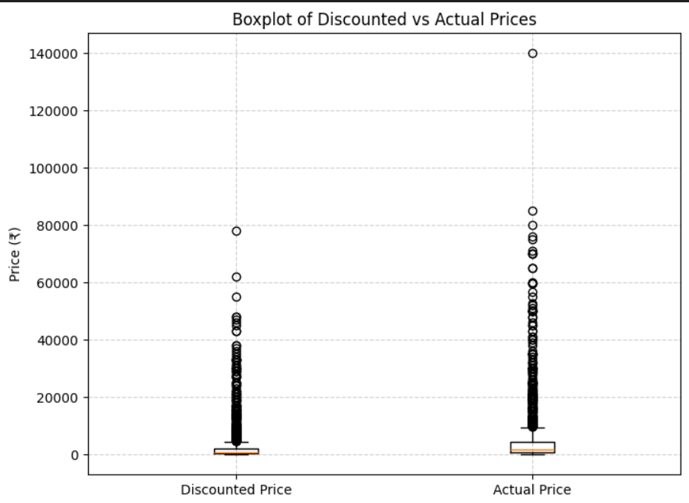
Plot distribution of actual price
1. Plotting the Distribution of Actual Price in Python (Using Seaborn)
If you’re working with Python (and have a dataset like amazon_data.csv), you can create a distribution plot using libraries like Seaborn and Matplotlib.
2. Plotting the Distribution of Actual Price in Excel
If you're using Excel, you can also plot the distribution of prices.

Slide 10
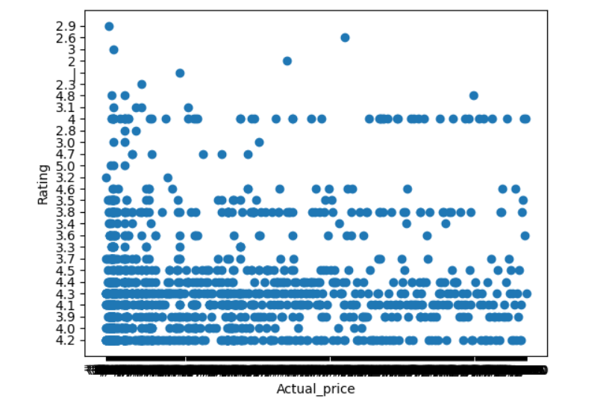
Plot actual price vs rating

Slide 11
PLOT ACTUAL PRICE VS RATING
1. Scatter Plot: Actual Price vs Rating in Python (Using Seaborn/Matplotlib)
If you're using Python, you can use Seaborn or Matplotlib to create a scatter plot.
Scatter Plot: Actual Price vs Rating in Excel
If you're using Excel, you can also create a scatter plot to visualize the relationship between actual price and rating.

Slide 12
Thank You

